Slide 1
BIOE 498 / BIOE 599: Computational Systems Biology for Medical Applications CSE 599V: Advancing Biomedical Models Lecture 6: Model Solutions & System Response
Joseph L. Hellerstein*
Herbert Sauro**
*eScience Institute, Computer Science & Engineering
**BioEngineering

Slide 2
Notes
Model solution: PDF solvers
Characteristics: stable ODEs (an ODE and numerical algorithm property), convergence of numerical solution to the true solution
Euler, Adam’s, CVODE, stiff
Solving in python, Tellurium
System response
Thermo in brief
Open systems and their characteristics
Reversible system in equilibrium
Reversible system in steady state in an open system
Transient, steady state
Solving in Tellrium
Interesting system motifs - Tyson

Slide 3
Numerical Solutions to Differential Eqns
Euler and its intuition
What we want
Stability
Convergence
Efficiency
Midpoint method
Backward Euler with Runge Cute
Packages

Slide 4
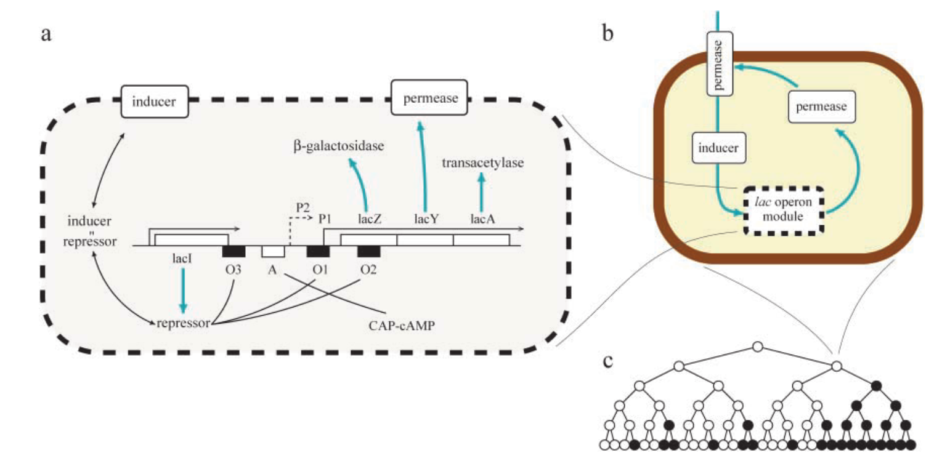
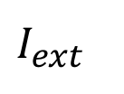
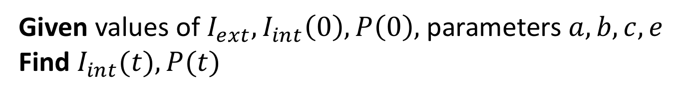
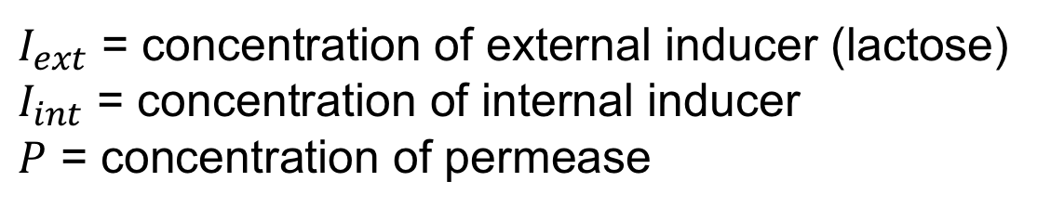
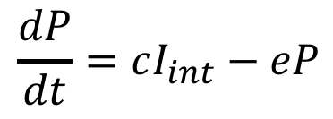

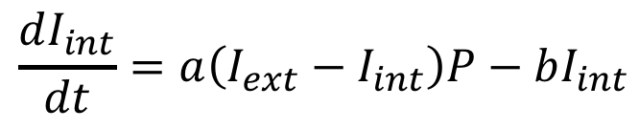

Motivation: Model of the lac Operon
System Diagram
$I_{ext}$
$$\frac{dI_{int}}{dt}=a\left(I_{ext}−I_{int}\right)P−bI_{int}$$
$$P$$
$$I_{int}$$
$$\frac{dP}{dt}=cI_{int}−eP$$
$I_{ext}$ = concentration of external inducer (lactose)
$I_{int}$ = concentration of internal inducer
$P$ = concentration of permease
*Vilar et al., 2003. Journal of Cell Biology.
Given values of $I_{ext},I_{int}\left(0\right), P\left(0\right),$parameters $a,b,c,e$
Find $I_{int}(t),P(t)$
Notes:
State vs. input variables for time?

Slide 5
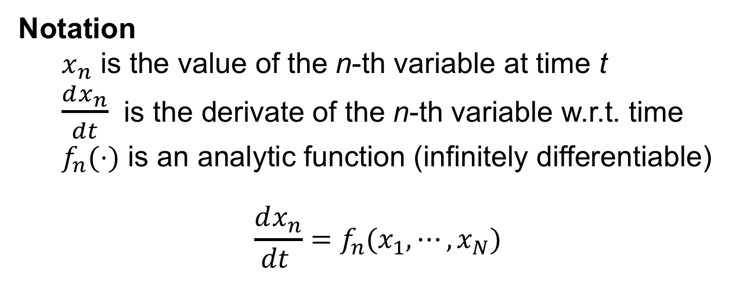
Initial Value Problem (IVP)
Given
N ordinary differential equations in N variables
Values for the N variables at time 0
Find
Values of the N variables over time
Notation
$x_{n}$ is the value of the n-th variable at time t
$\frac{dx_{n}}{dt}$ is the derivate of the n-th variable w.r.t. time
$f_{n}(⋅)$ is an analytic function (infinitely differentiable)
$$\frac{dx_{n}}{dt }=f_{n}(x_{1},⋯,x_{N})$$
Notes:
State vs. input variables for time?

Slide 6
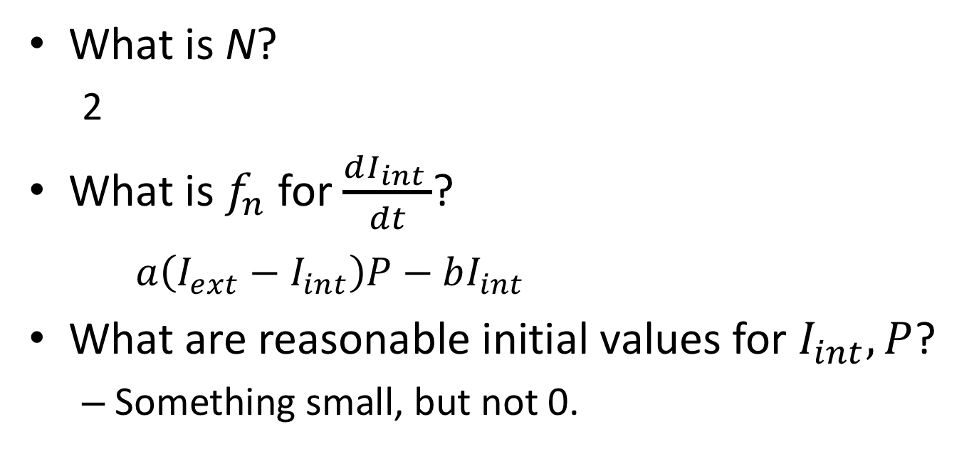
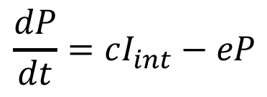
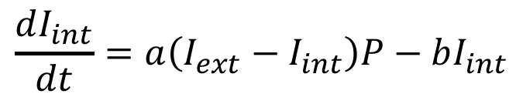
IVP for lac Operon
$$\frac{dI_{int}}{dt}=a\left(I_{ext}−I_{int}\right)P−bI_{int}$$
$$\frac{dP}{dt}=cI_{int}−eP$$
What is N?
2
What is $f_{n}$ for $\frac{dI_{int }}{dt}$?
$a\left(I_{ext}−I_{int}\right)P−bI_{int}$
What are reasonable initial values for $I_{int},P$?
Something small, but not 0.
Notes:
State vs. input variables for time?

Slide 7
Euler Algorithm

Slide 8
Issues With Euler

Slide 9
Improvement 1

Slide 10
MATLAB Solvers

Slide 11
Python Solvers and Usage

Slide 12
Requirement for a Numerical Solution
The function is “smooth enough”
Two ways of expressing “smooth enough”
Lipschitz continuity
Smooth and uniformly monotone decreasing
If smooth enough, then
a solution will exist and be unique
we will be able to approximate it accurately with a wide variety of method

Slide 13
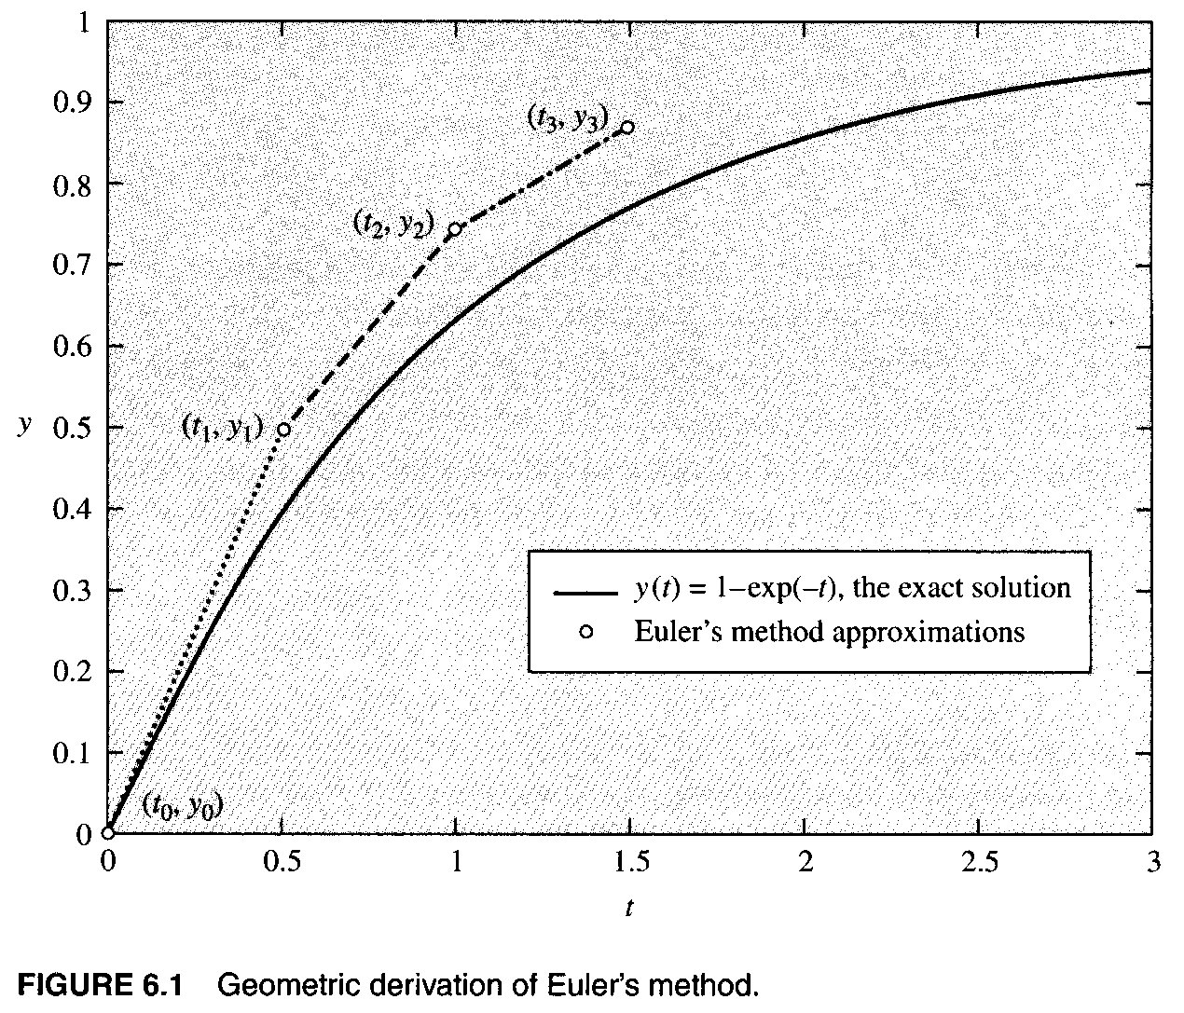

Slide 14
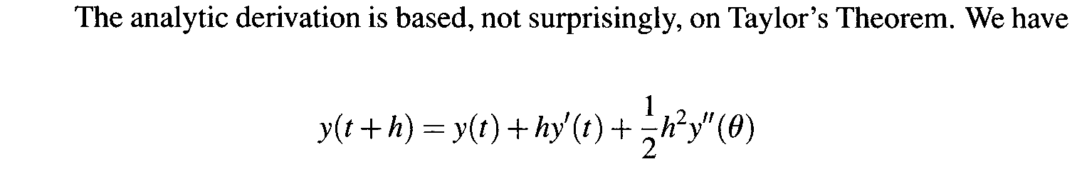
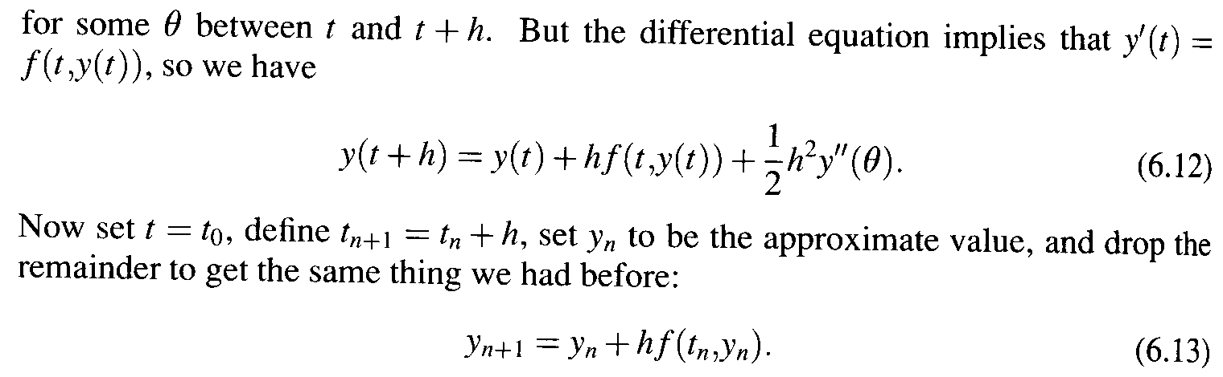
Analytic Derivation

Slide 15

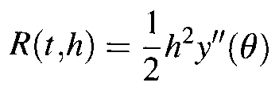
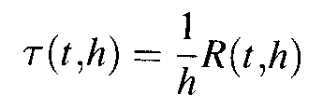
Error Estimation for Euler’s Method
By the analytic derivation, we have
The residual for Euler’s method:
The truncation error:

Slide 16
Discussion
Both error theorems show that Euler’s method is only first-order accurate (O(h)).
If f is only Lipschitz continuous, then the constants multiplying the initial error and the mash parameter can be quite large, rapidly growing.
If f is smooth and uniformly monotone decreasing in y, then the constants in the error estimate are bounded for all n.

Slide 17
6.4 Variants of Euler’s Method
Euler’s method is not the only or even the best scheme for approximating solutions to initial value problems.
Several ideas can be considered based on some simple extensions of one derivation of Euler’s method.

Slide 18

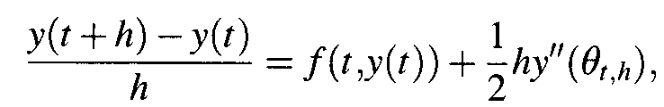
Variants of Euler’s Method
We start with the differential equation
And replace the derivative with the simple difference quotient derived in (2.1)
What happens if we use other approximations to the derivative?

Slide 19
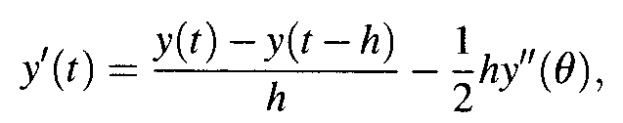

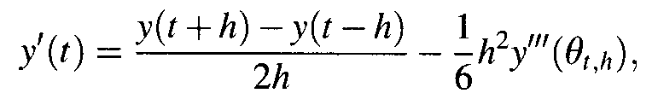

Variants of Euler’s Method
If we use
then we get the backward Euler method
If we use
then we get the midpoint method
O(h)
Method 1
O(h²)
Method 2

Slide 20
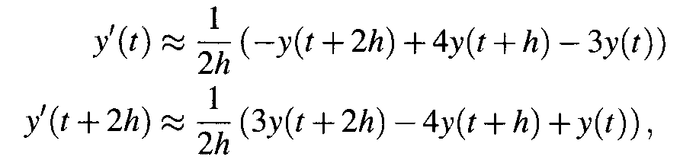

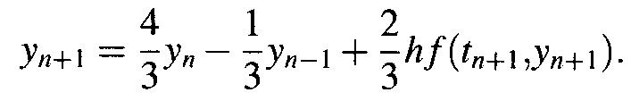
Variants of Euler’s Method
If we use the methods based on interpolation (Section 4.5)
then we get two numerical methods
O(h²)
O(h²)
Method 3
Method 4

Slide 21
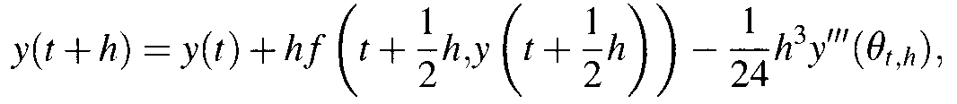

Variants of Euler’s Method
We can use a midpoint rule approximation to integrating (6.23)
and get
O(h³)
Method 6

Slide 22
Discussion
What about these method? Are any of them any good?
Observations
Methods 2, 3, and 4 are all based on derivative approximations that are O(h²), thus they are more accurate than Euler method and method 1 (O(h)).
Similarly, methods 5 and 6 are also more accurate.
Methods 2, 3, and 4 are not single-step methods, but multistep methods. They depend on information form more than one previous approximate value of the unknown function.

Slide 23


Discussion
Observations (con.)
Concerning methods 1, 4, and 5, all of these formulas involve we cannot explicitly solve for the new approximate values Thus these methods are called implicit methods.
Methods 2 and 3 are called explicit methods.

Slide 24
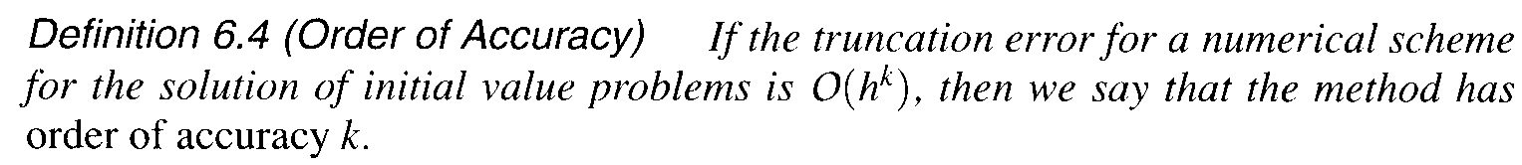
Definition 6.4

Slide 25
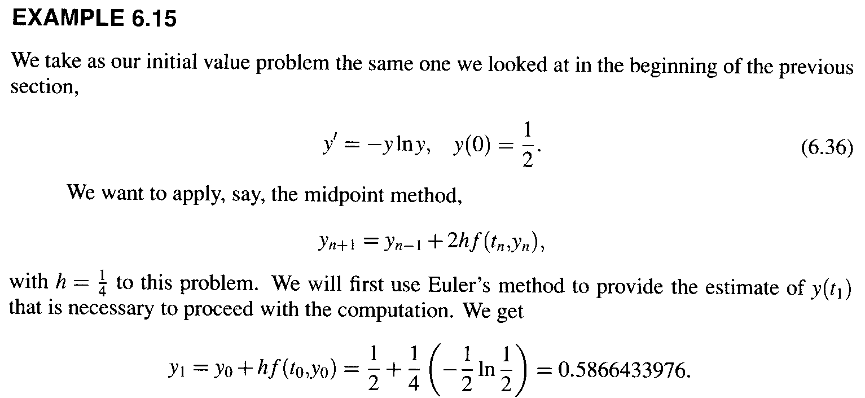
6.4.3 Starting Values and Multistep Method
How to find the starting values?

Slide 26
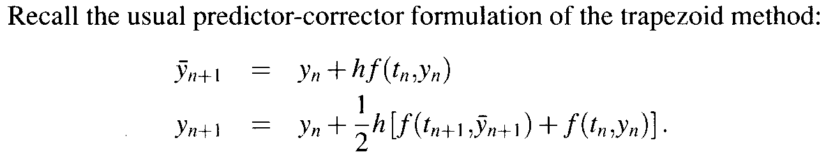
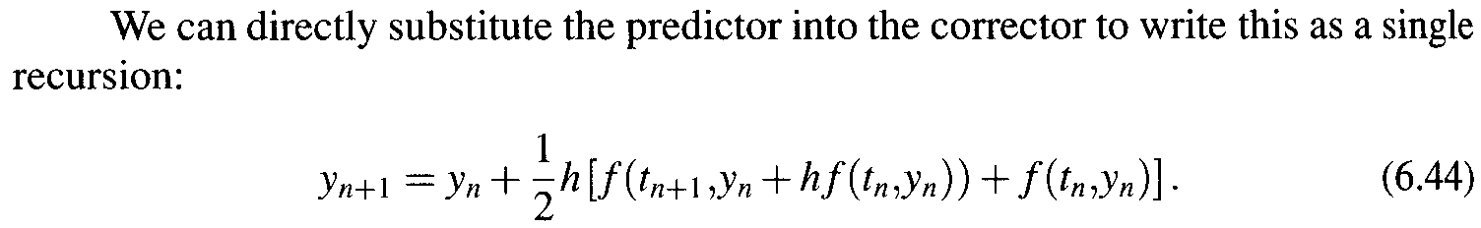
6.5 Single-step Method: Runge-Kutta
The Runge-Kutta family of methods is one of the most popular families of accurate solvers for initial value problems.

Slide 27
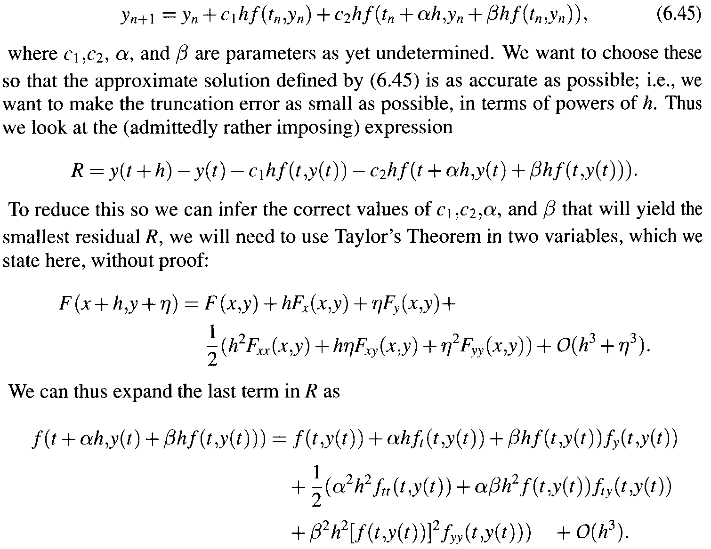
Consider the more general method:
Residual

Slide 28
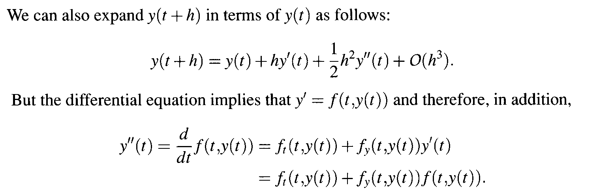
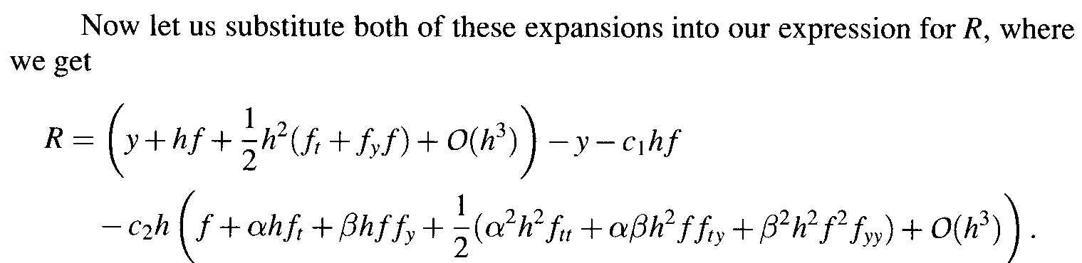

Slide 29
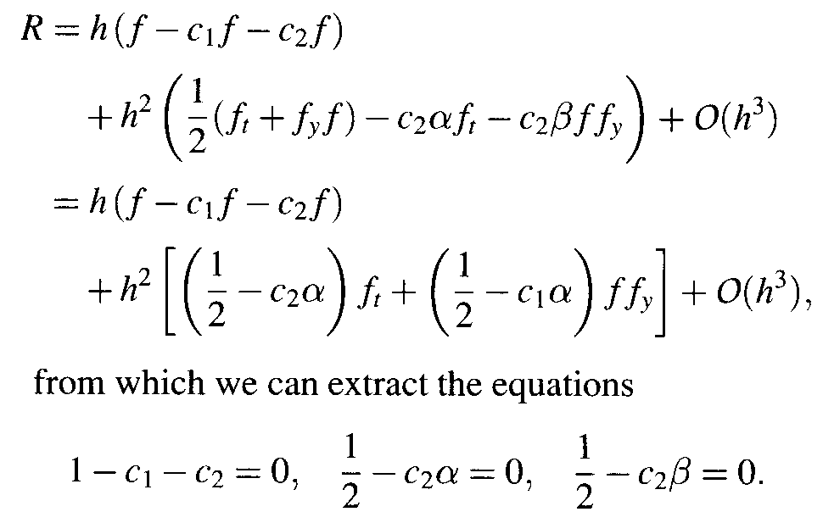
Rewrite the formula of R, we get

Slide 30
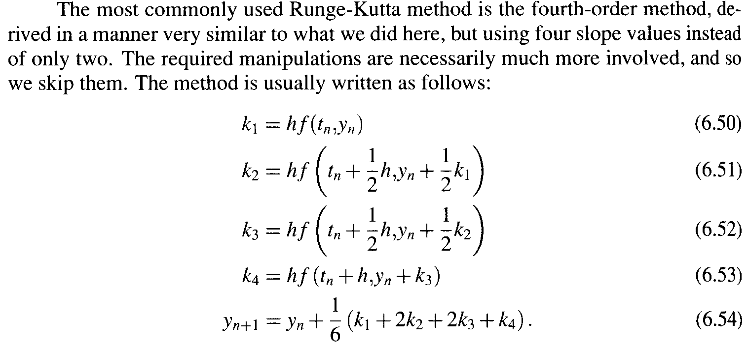
Runge-Kutta Method

Slide 31
6.6 Multistep Methods
6.6.1 The Adams families
Adams families include the following most popular ones:
Explicit methods: Adams-Bashforth families
Implicit methods: Adams-Moulton families

